Slide 1
TellCo User Analytics
Customer Overview • Engagement • Experience • Satisfaction
Data-driven assessment of customer behavior, network experience and growth opportunities
CUSTOMERS
xDR RECORDS
FEATURES
106,857
150,001
55
customer-level analysis
one-month snapshot
source dataset
Nexthikes IT Solutions
Isha Bardia

Slide 2
Executive Summary
What the four analyses say about TellCo's customer base
CUSTOMER BASE
HIGH ENGAGEMENT
GOOD EXPERIENCE
AVG SATISFACTION
106,857
24,450
34,652
1.78
unique customer-level records
22.9% of customers
32.4% of customers
derived satisfaction score
Growth signal
Investment caveat
The data reveals identifiable customer segments, strong application demand and meaningful network-experience differences. These create operational opportunities to improve engagement and service quality.
The dataset is behavioral/network data for one month. It does not provide the financial evidence required to value TellCo independently, so the purchase recommendation should remain conditional on financial and commercial due diligence.
TellCo User Analytics
2

Slide 3
Data & Analytical Approach
From raw xDR sessions to customer-level decision insights
SOURCE
150,001 xDR records • 55 source features • one-month snapshot
• Customer aggregation by MSISDN/Number
• Missing-value handling and IQR-based outlier treatment
• Task 1: overview + application behavior + PCA
• Task 2: engagement metrics + K-Means segmentation
• Task 3: TCP retransmission + RTT + throughput + K-Means
• Task 4: derived scores + satisfaction regression + K-Means + MySQL
TellCo User Analytics
3

Slide 4
Customer & Device Overview
Handset concentration creates clear marketing and compatibility priorities
What stands out
Huawei B528S-23A is the most observed handset (19,752 records). Apple leads the top-three manufacturer group with 59,565 observations, followed by Samsung (40,839) and Huawei (34,423).
TellCo User Analytics
4

Slide 5
Application Usage
Gaming and 'Other' dominate customer-level application traffic
GAMING
OTHER
60,116.84 GB
59,981.65 GB
largest application category
second-largest category
Analytical signal
YOUTUBE
Application traffic is highly correlated with total traffic (approximately 0.966–1.000 across the seven application variables). PCA also shows PC1 explaining about 97.5% of application-usage variance, indicating a strong common usage factor.
3,163.26 GB
third-largest category
Interpretation: Resource planning should focus on the services that generate the largest share of data demand, while monitoring whether 'Other' traffic contains additional high-value use cases.
TellCo User Analytics
5

Slide 6
EDA & Behavioral Patterns
Usage distributions are highly skewed and become more traffic-intensive at longer durations
AVG SESSIONS / CUSTOMER
AVG TRAFFIC / CUSTOMER
AVG SESSION DURATION
PC1 VARIANCE
1.40
0.648 GB
0.0408 hr
≈97.5%
median = 1
median = 0.575 GB
≈ 2.45 minutes
application usage
Distribution
Duration deciles
Mean values are generally above medians, indicating right-skewed customer usage. Total traffic, download volume, Gaming and Other show especially large dispersion.
Traffic rises materially in the highest duration deciles. Decile 10 accounts for about 14,337 GB of total traffic versus about 5,984 GB in decile 6, showing a strong link between longer usage and traffic demand.
Implication
The customer base is heterogeneous: a small set of heavy users can drive a disproportionate amount of network demand. Capacity and retention strategies should therefore be segment-aware.
TellCo User Analytics
6

Slide 7
User Engagement Segmentation
K-Means groups customers into three distinct behavioral profiles
LOW ENGAGEMENT
MEDIUM
57,825
24,582
54.1%
23.0%
HIGH ENGAGEMENT
Cluster profiles
24,450
High Engagement customers are above average across frequency, duration and traffic. Low Engagement customers are below average across all three. Medium Engagement customers have longer durations but lower frequency and traffic.
22.9%
The notebook also applies the elbow method and identifies k = 5 as a reasonable candidate for a more granular segmentation, although the elbow is not sharply defined.
TellCo User Analytics
7

Slide 8
Engagement Cluster Profiles
Normalized K-Means centers show how the three groups differ
Segment | Customers | Session Freq. Avg | Duration Avg (hr) | Traffic Avg (GB)
Low Engagement | 57,825 | 1.03 | 0.0193 | 0.468
High Engagement | 24,450 | 2.17 | 0.0450 | 0.933
Medium Engagement | 24,582 | 1.03 | 0.0480 | 0.458
Business interpretation
High-engagement users represent a smaller but materially more active segment. Their higher traffic and frequency make them important for network capacity, targeted offers and retention analysis.
TellCo User Analytics
8

Slide 9
Application Engagement & Cluster Optimization
Where customers spend data and how many engagement segments may be useful
Elbow method
2
3
4
5
6
7
8
9
10
Finding
Gaming is the dominant application category, followed closely by Other. The elbow curve flattens around k = 5; the notebook treats k = 5 as a reasonable candidate rather than a definitive optimum.
TellCo User Analytics
9

Slide 10
User Experience Analytics
Network experience is assessed using TCP retransmission, RTT and throughput
AVG TCP RETRANSMISSION
AVG RTT
AVG THROUGHPUT
7.37M bytes
≈42 ms
≈4.23 Mbps
after outlier treatment
customer-level result
record-level outlier treatment
Metric | Outliers | Share | Replacement mean
TCP retransmission | 2,581 | 1.72% | 7.20M
RTT | 8,012 | 5.34% | 39.33 ms
Throughput | 13,251 | 8.83% | 4,234.76 kbps
Interpretation
The experience variables have very different scales and dispersion. Standardization before K-Means is therefore essential so TCP retransmission does not dominate the clustering solely because of its numerical magnitude.
Customer-level aggregation: 106,857 customers
TellCo User Analytics
10

Slide 11
Experience by Handset
Observed handset performance varies substantially across models
TOP THROUGHPUT HANDSET
LOWEST THROUGHPUT GROUP
TOP TCP RETRANSMISSION
Tecno H. Phantom6 Plus
mostly ≤1.5 kbps
Samsung Galaxy Core 2
≈27,099 kbps
bottom 10 handset types
≈23.28M bytes
TellCo User Analytics
11

Slide 12
Experience Segmentation (K = 3)
Three groups emerge from standardized TCP, RTT and throughput
Experience | Customers | Avg TCP (bytes) | Avg RTT (ms) | Avg Throughput (kbps)
Good | 34,652 (32.4%) | 1.91M | 39.84 | 9,775.91
Moderate | 45,450 (42.5%) | 10.17M | 22.40 | 725.90
Poor | 26,755 (25.0%) | 9.68M | 66.38 | 1,193.01
Profile interpretation
Good Experience combines low retransmission with high throughput. Poor Experience combines high RTT and low throughput. Moderate Experience is the largest group and has lower RTT but much lower throughput.
TellCo User Analytics
12

Slide 13
From Engagement & Experience to Satisfaction
The project defines satisfaction as a derived score, not a survey measure
Engagement model
Experience model
Satisfaction score
Distance to less-engaged cluster
Distance to worst-experience cluster
(Engagement + Experience) / 2
AVG ENGAGEMENT SCORE
AVG EXPERIENCE SCORE
AVG SATISFACTION SCORE
1.59
1.98
1.78
derived distance measure
derived distance measure
median = 1.74
Important interpretation
Because the scores are distances from 'bad' reference clusters, higher scores indicate greater distance from those reference points. The score is therefore a constructed analytical measure, not direct customer sentiment.
TellCo User Analytics
13

Slide 14
Top 10 Customers by Derived Satisfaction
Highest scores combine relatively strong engagement and experience distances
Rank | Customer ID | Engagement | Experience | Satisfaction
1 | 33699856436 | 5.38 | 4.60 | 4.988
2 | 33659324811 | 5.59 | 4.21 | 4.904
3 | 33638429285 | 5.81 | 3.80 | 4.809
4 | 33668436827 | 5.46 | 4.13 | 4.799
5 | 33760919975 | 5.51 | 4.09 | 4.798
6 | 33663374648 | 5.68 | 3.83 | 4.753
7 | 33698180764 | 5.40 | 4.10 | 4.751
8 | 33665700091 | 5.66 | 3.68 | 4.670
9 | 33665596600 | 5.50 | 3.82 | 4.662
10 | 33660288815 | 4.95 | 4.33 | 4.643
TOP SCORE
4.988
customer 33699856436
TOP-10 RANGE
4.64–4.99
vs overall mean 1.78
Interpretation
The top 10 are far above the overall average on this derived satisfaction metric. They are useful as a benchmark segment for understanding high-value usage and network conditions.
TellCo User Analytics
14

Slide 15
Satisfaction Prediction Model
Random Forest regression predicts the derived satisfaction score
R²
MAE
RMSE
MODEL
0.9953
0.0234
0.0479
Random Forest
99.53% variance explained
mean absolute error
root mean squared error
100 estimators
Interpretation
Session Frequency has the largest model feature importance (0.413), followed by Average RTT (0.231). These are model contributions, not evidence of causality.
Model caveat
The target is mathematically derived from the same engagement and experience information used as predictors. The very high R² is therefore expected and should not be interpreted as proof that the model predicts independent customer sentiment.
TellCo User Analytics
15

Slide 16
Satisfaction Segmentation (K = 2)
Clusters differ in engagement/experience profiles, while average satisfaction is almost identical
Cluster label | Customers | Share | Avg Engagement | Avg Experience | Avg Satisfaction
Lower Satisfaction | 61,245 | 57.3% | 1.008 | 2.547 | 1.778
Higher Satisfaction | 45,612 | 42.7% | 2.367 | 1.208 | 1.788
Key finding
The two clusters are structurally different: one has higher experience and lower engagement, while the other has higher engagement and lower experience. However, their average satisfaction scores differ by only about 0.01.
Do not overstate the labels
The cluster labels are descriptive. The near-identical satisfaction averages mean the segmentation is more useful for profiling engagement/experience trade-offs than for claiming a large satisfaction gap.
TellCo User Analytics
16

Slide 17
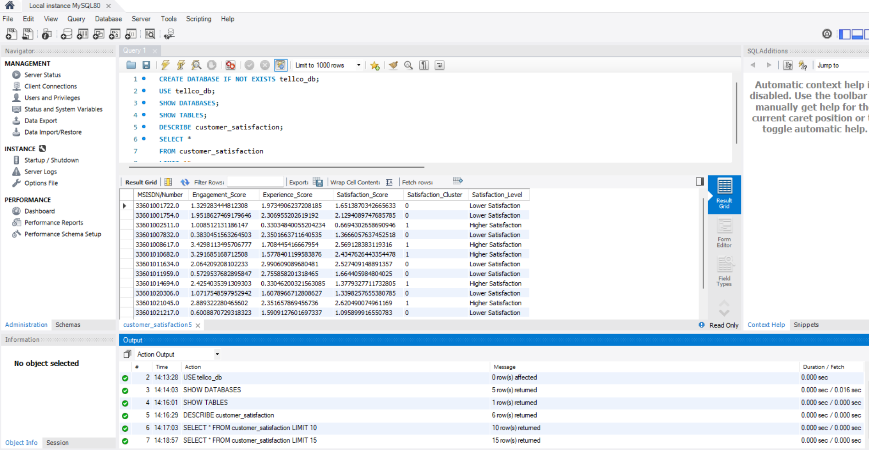
Data Export, Dashboard
Evidence of the customer-level MySQL table and model artifacts
MySQL export
The final customer table contains 106,857 rows with MSISDN, engagement score, experience score, satisfaction score, cluster and satisfaction level. The supplied SELECT output confirms the table is populated.
Model artifacts
The Task 4 notebook saves the satisfaction regression model and supporting feature/scaler/K-Means artifacts for reuse.
Supplied MySQL SELECT output
TellCo User Analytics
17

Slide 18
Growth Potential & Purchase Recommendation
A data-backed operating case exists, but the acquisition decision requires financial due diligence
GROWTH POTENTIAL
PURCHASE VIEW
Positive operational opportunity
Conditional consideration
• 24,450 customers are classified as High Engagement (22.9%).
• 34,652 customers are classified as Good Experience (32.4%).
• Gaming and Other together account for about 120,098 GB of observed application traffic.
• The analysis identifies distinct customer profiles that can support targeted retention, capacity and service-quality actions.
• The customer/network evidence indicates identifiable opportunities to improve commercial and operational performance.
• However, the supplied analysis does not contain valuation, revenue, margin, cash-flow, debt, churn economics or ROI evidence.
• Proceed only if financial, commercial, regulatory and technical due diligence supports an acceptable acquisition case.
Decision principle
Use this analysis to prioritize what to investigate and where growth may be created—not as a standalone valuation or purchase-price decision.
TellCo User Analytics
18

Slide 19
Limitations & References
What should be completed or validated before the final investment decision
Key limitations
• One-month behavioral snapshot; not a longitudinal customer view.
• Derived satisfaction is not survey-based sentiment.
• Mean/IQR outlier treatment can reduce extreme-value information.
• Very high regression R² is partly structural because the target is derived from predictor information.
• Financial and valuation evidence is outside the supplied dataset.
References / source artifacts
• Telecommunication_Project_Task1&2.ipynb — Customer overview, application usage and engagement analysis
• Telecommunication_Project_Task3.ipynb — Experience metrics, handset analysis and K-Means segmentation
• Telecommunication_Project_Task4.ipynb — Satisfaction scoring, regression, K-Means and MySQL export
• Supplied MySQL SELECT query screenshot — customer_satisfaction table evidence
• Project brief — final presentation, dashboard, data analysis code and Task 4.7 requirements
TellCo User Analytics
19

Slide 20
THANKYOU

